Slide 1
Analytics Portfolio
Jessica Gutstein

Slide 2
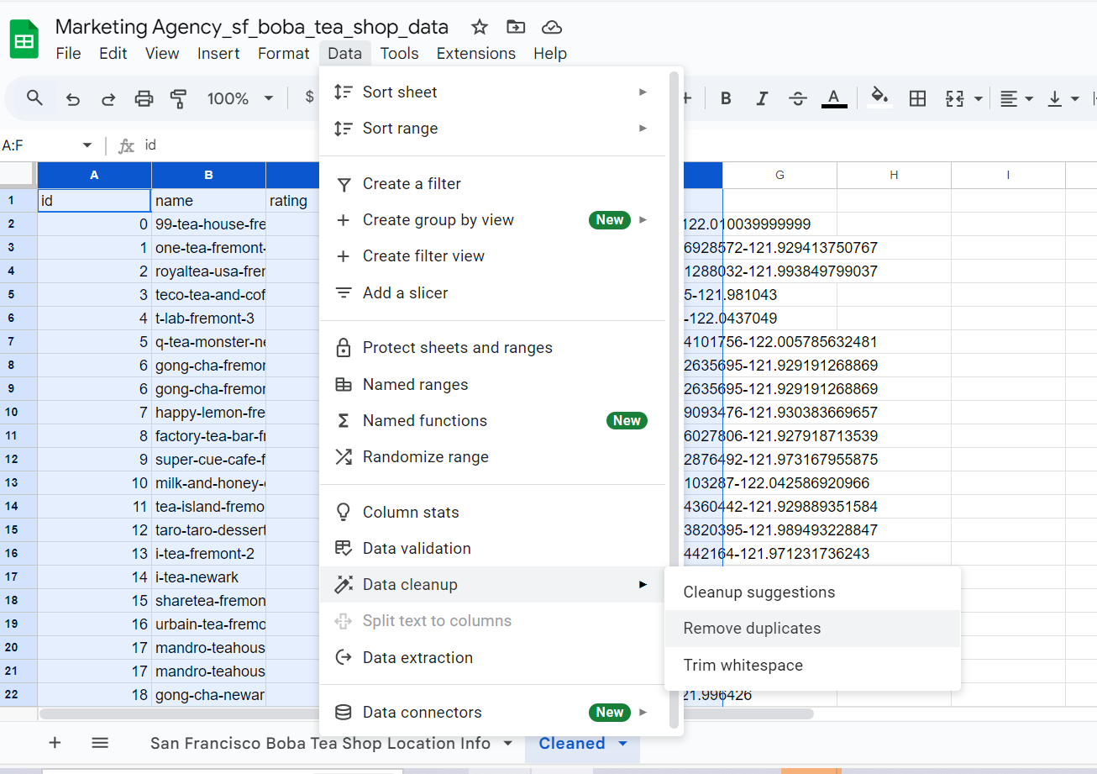
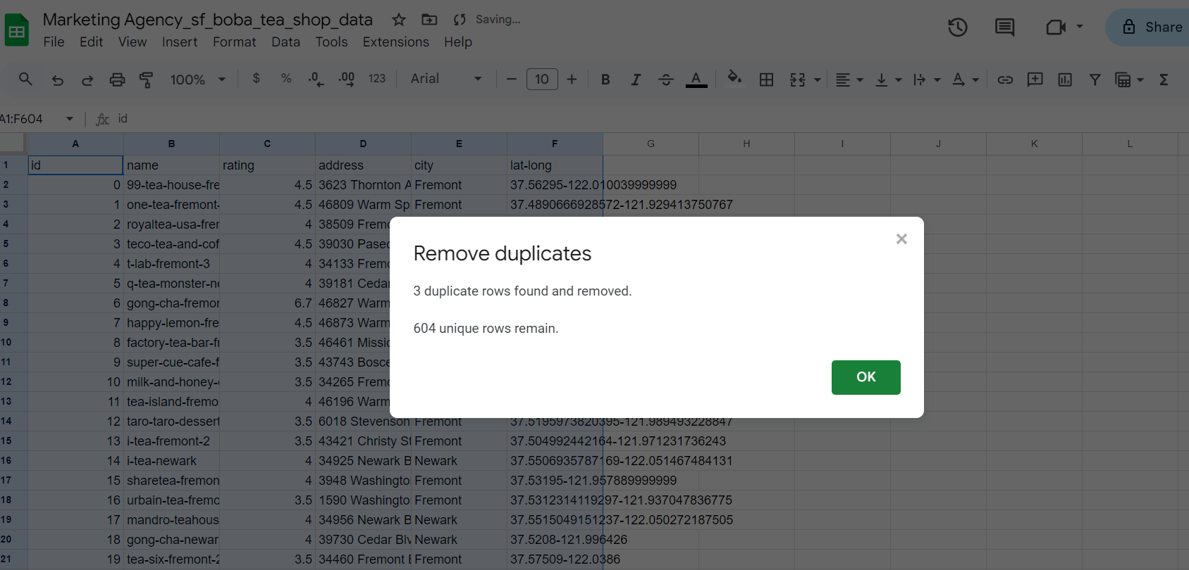
Dirty to Clean Data - Google Sheets Project
Skills: identify dirty elements using Google Sheets in a dataset, remove duplicate data, and use the COUNTIF and SPLIT functions to help clean data.
Dataset: Marketing Agency
https://docs.google.com/spreadsheets/d/1p5TiRjV-criLJTI7A0tBdMF0tEUiBIdjY3xL0KOGGHg/edit?usp=sharing

Slide 3
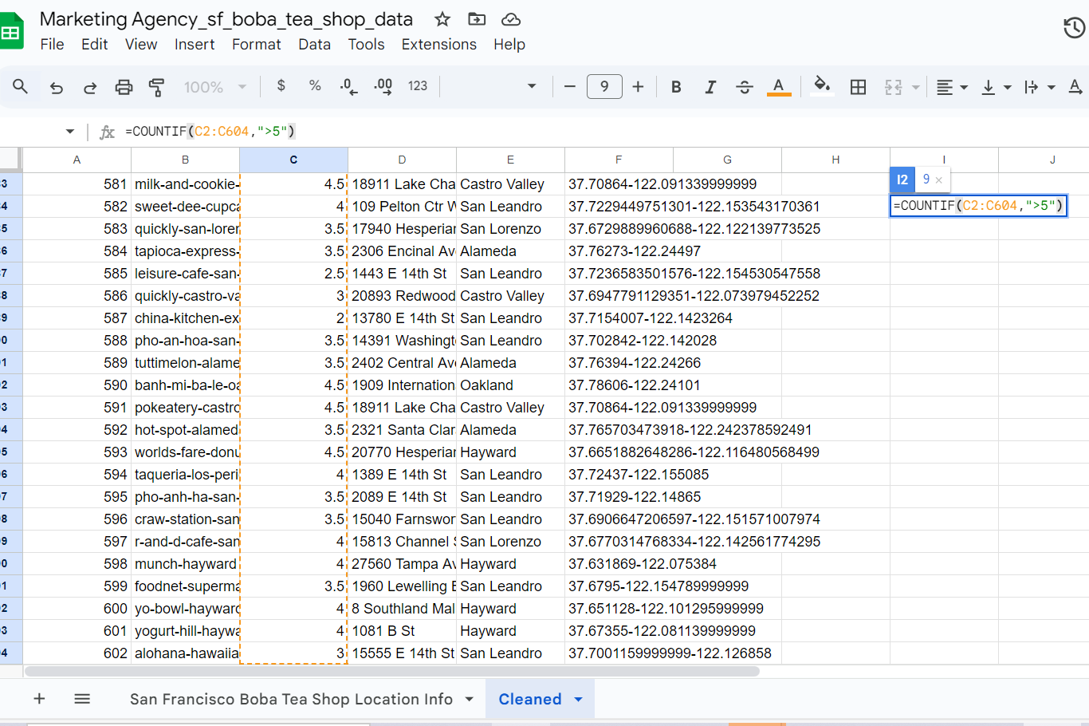
Functions - COUNTIF
Yelp Rates in Column C can only be between (0-5).
Using COUNTIF to determine if any values are over 5.
9 entries that have a rating greater than 5.
Solution:
Research Boba locations on yelp to find the accurate rankings, in this dataset example, the incorrect entries will be replaced with 5.

Slide 4
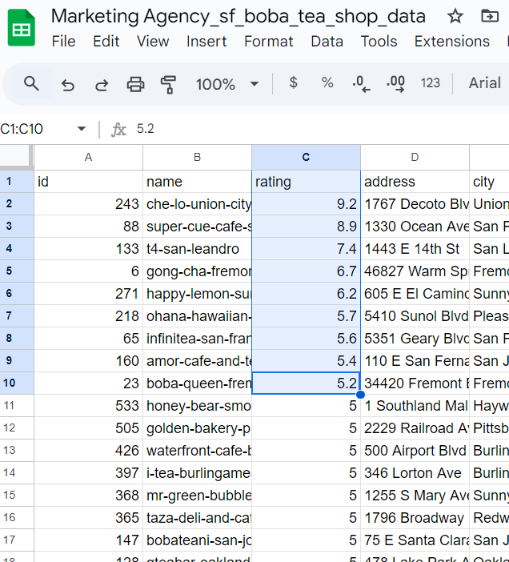
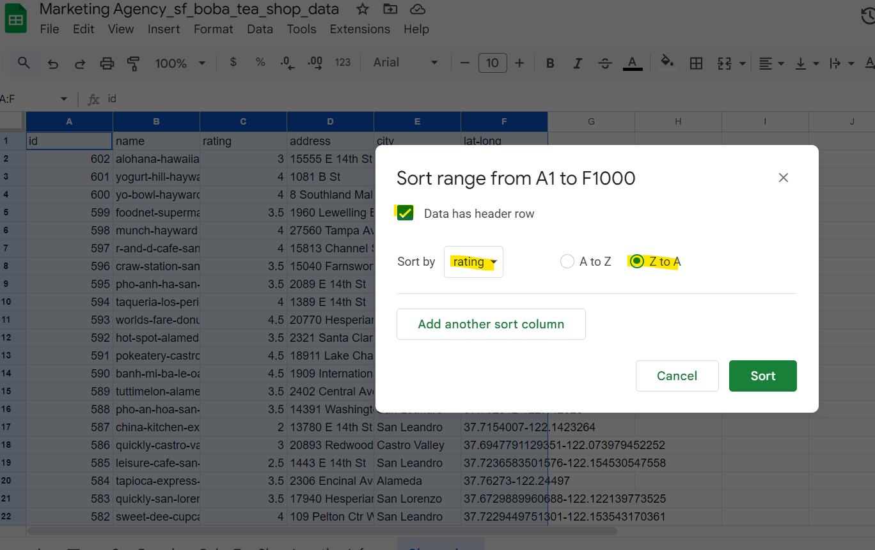
Sorting/Filtering
Solution: Replaced all 9 incorrect data entries with 5. To validate correction, the COUNTIF function will show 0 entries >5.

Slide 5
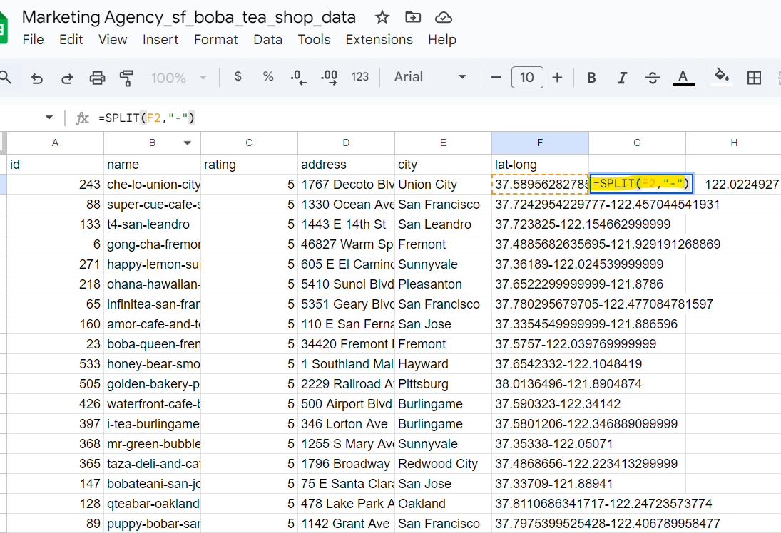
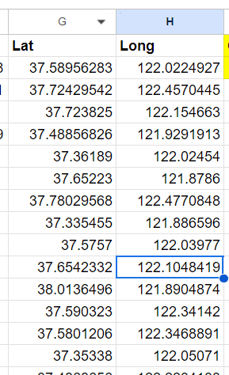
Functions - SPLIT

Slide 6
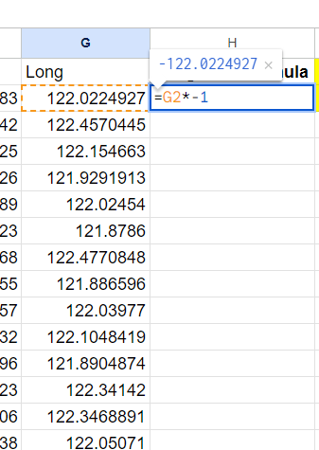
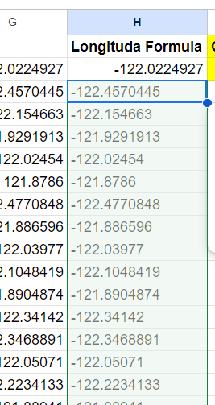
Formulas
Longitude values should be negative so that they are accurate coordinates for mapping.
=G2*-1

Slide 7
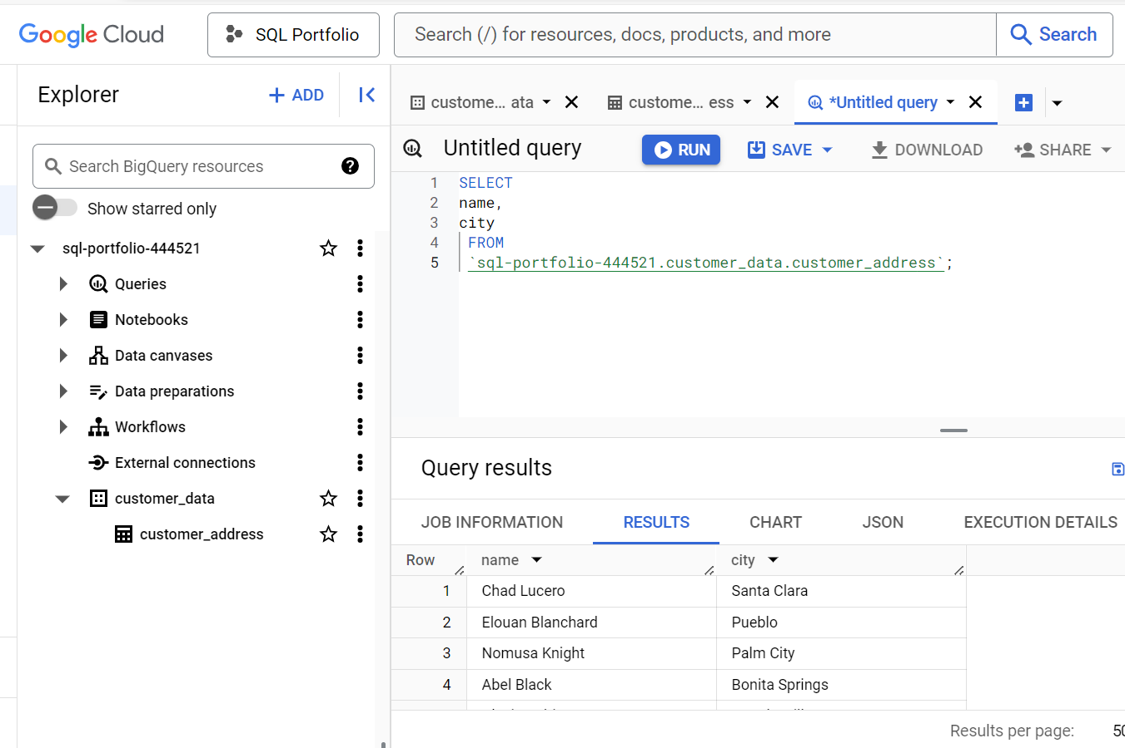
SQL - Common Queries

Slide 8
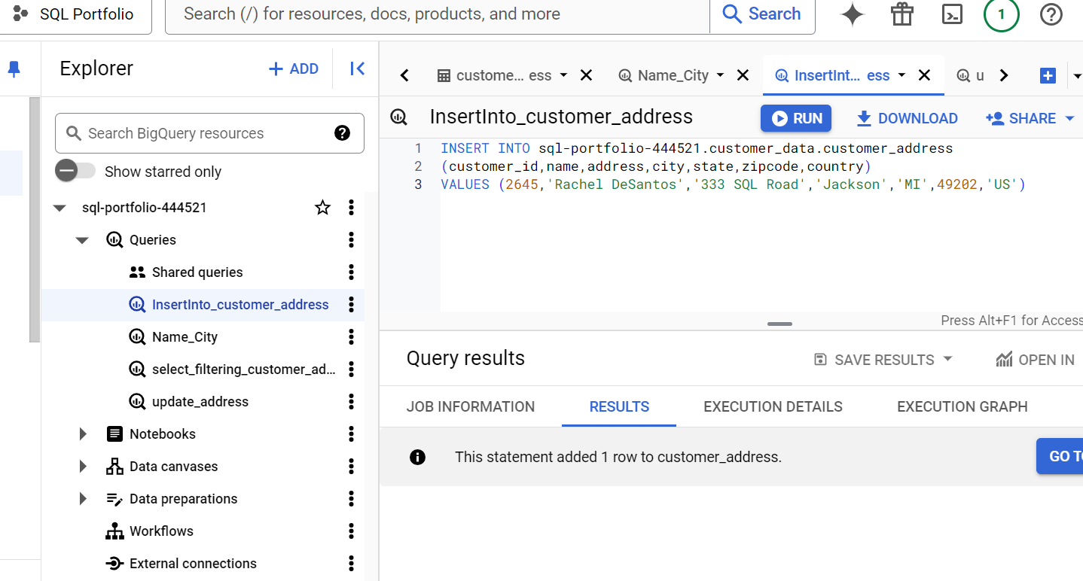
Identifies variable within a specific row

Slide 9
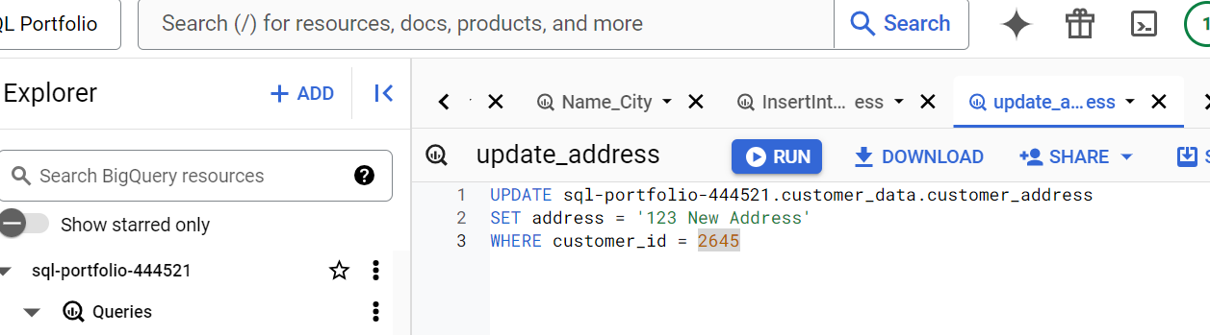
Updating a variable within a row

Slide 10
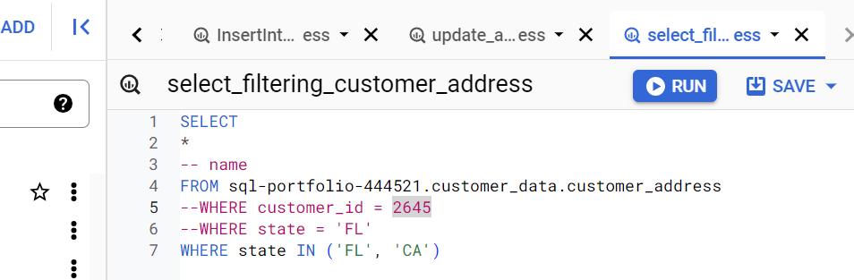
SQL-Filtering

Slide 11
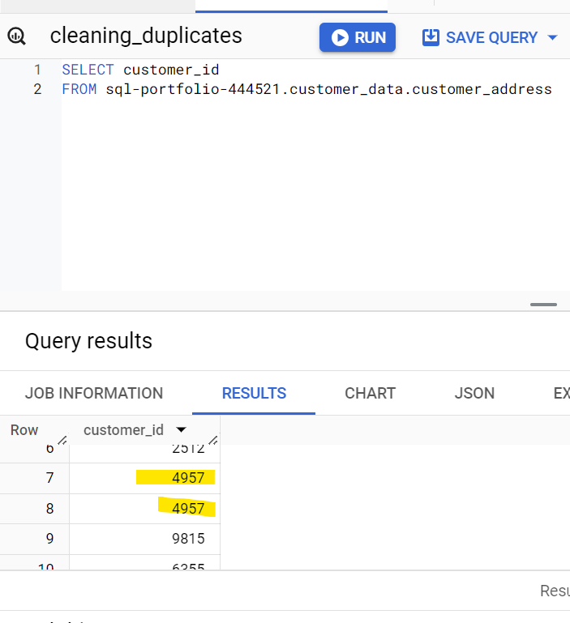
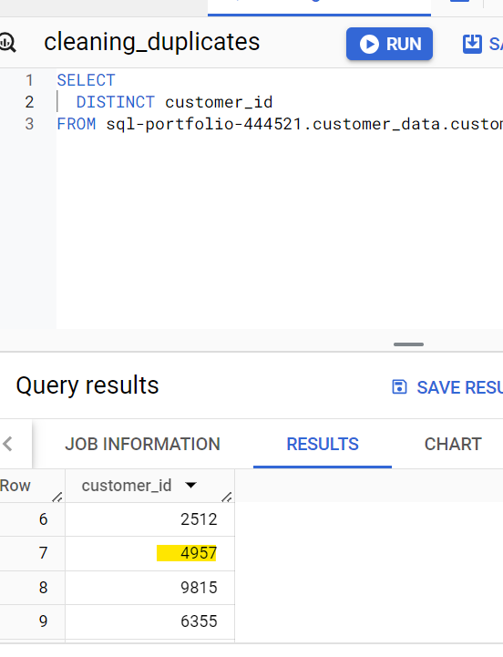
Cleaning String Variables - removing duplicates

Slide 12
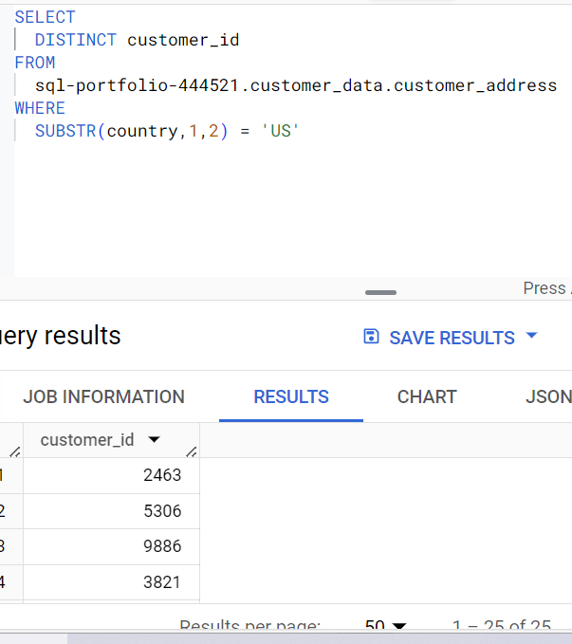
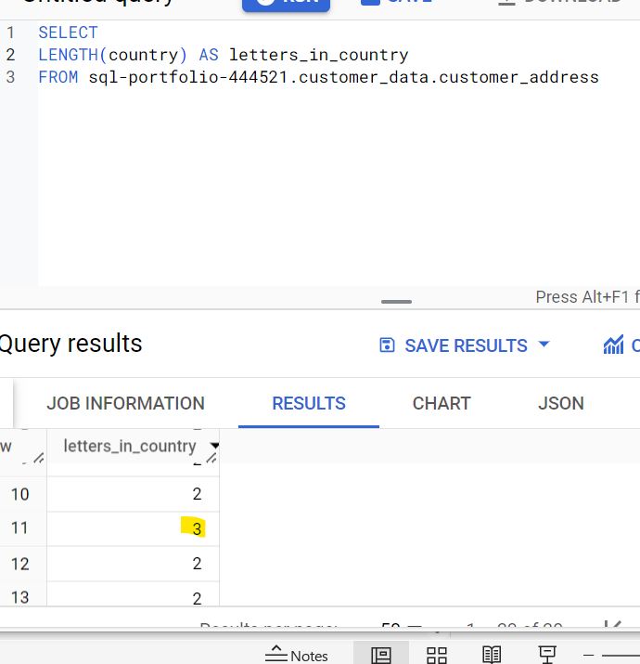
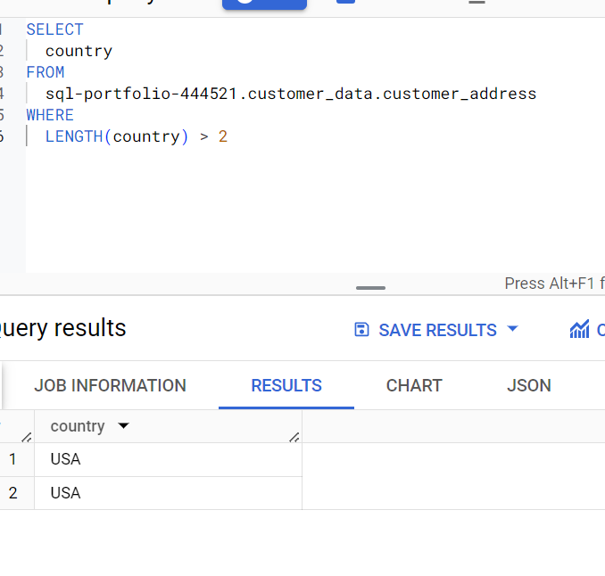
Functions - LENGTH / DISTINCT / SUBSTR

Slide 13
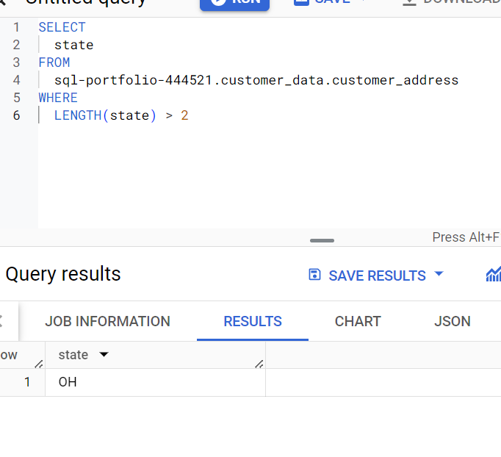
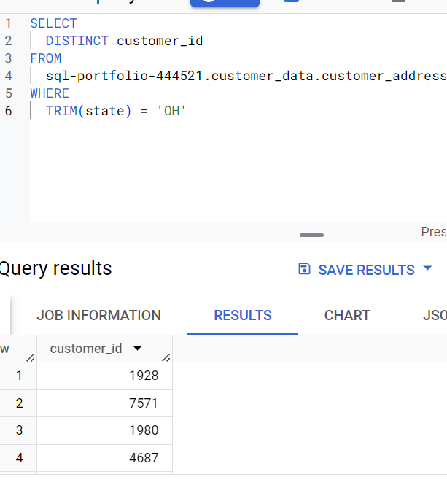
TRIM()
OH is not greater than 2 characters, so using the TRIM function will remove any spaces

Slide 14
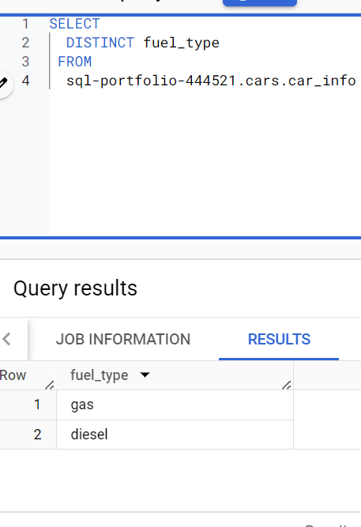
Dirty to Clean Data - SQL Project
Dataset: Automobiles
https://docs.google.com/spreadsheets/d/1uc563psJrCU6Gf0ftaWLXKXAF7czdONsKnaCgC5bz9c/edit?usp=sharing
Contains historical sales data, including details such as car features and prices. You can use this data to find the top 10 most popular cars and trims
Goal of project: clean data to avoid presenting inaccurate inventory, which could result in the company to lose money on their car investment
Automobile - UCI Machine Learning Repository - verifies that the fuel_type column should contain only two unique string values ‘diesel’ and ‘gas’.
See screenshot to verify fuel_type has the two unique strings.

Slide 15
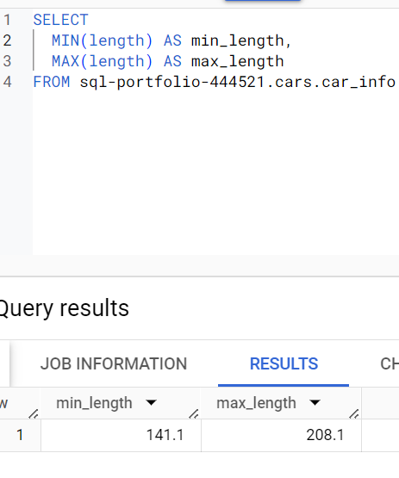
MAX/MIN Functions
Within the automobiles dataset, I wanted to know the (max/min) within the length column. When the query returned the values, I asked to make two new columns for the entries to fall into.

Slide 16
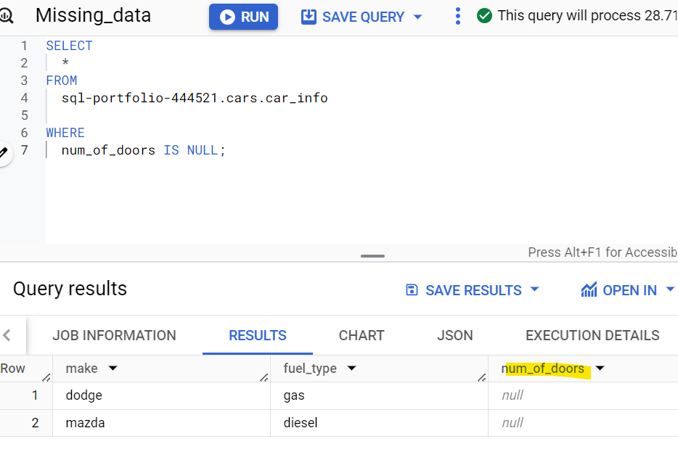
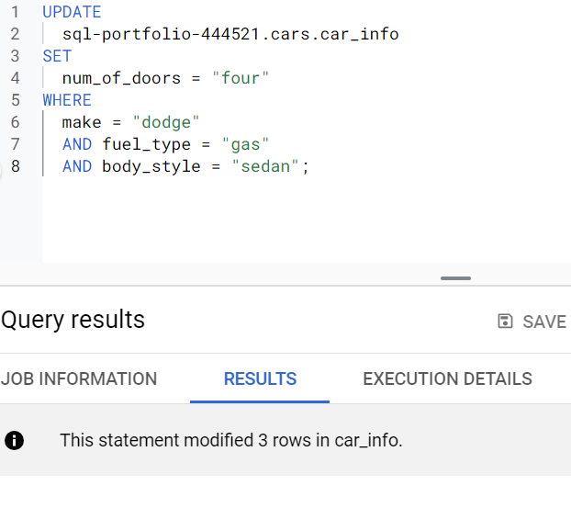
SQL - Missing Data
ALWAYS check data for null or missing values. Confirm replace with team or data owner and make correction.

Slide 17
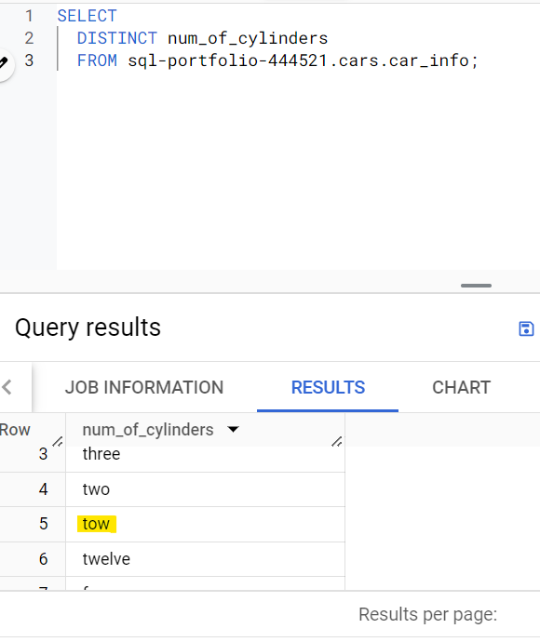
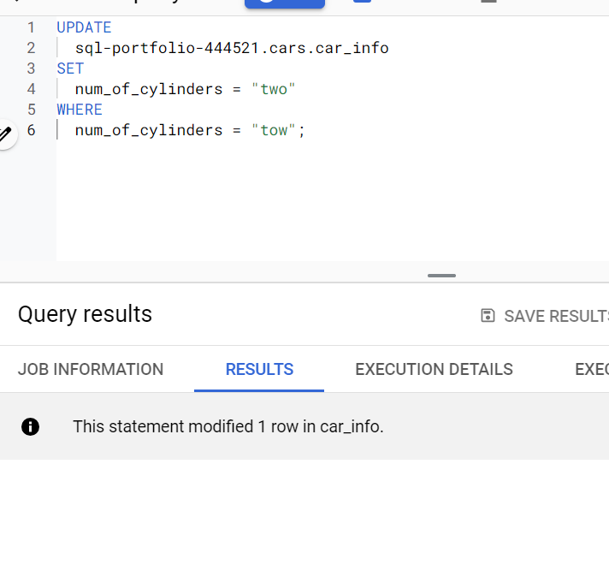
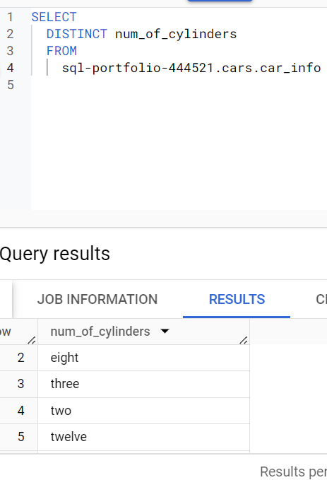
SQL - Correcting Misspelling
‘Tow’ is now corrected to ‘two’. The DISTINCT function only picks up ‘two’.

Slide 18
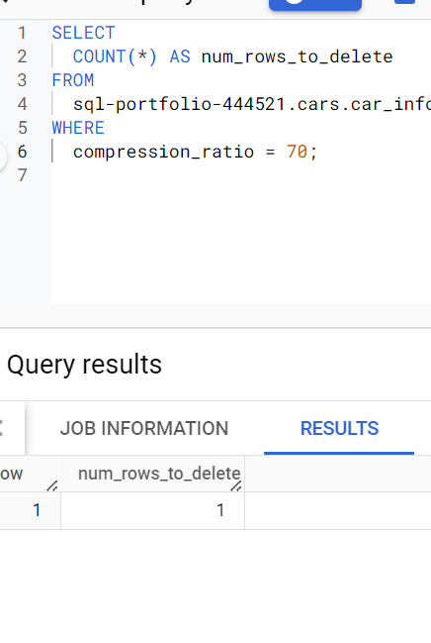
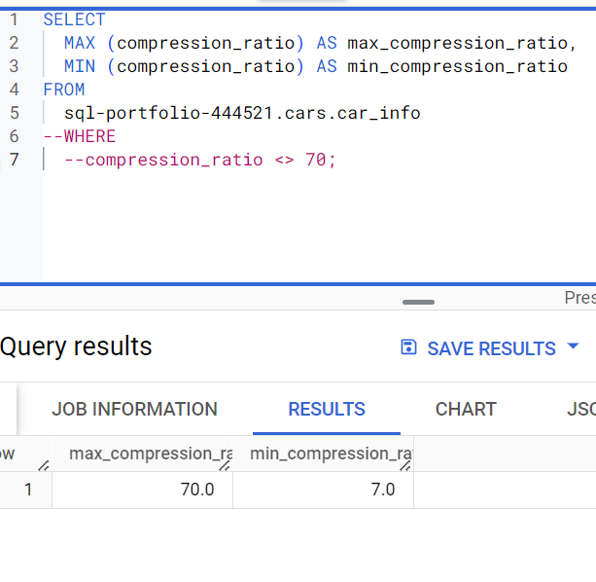
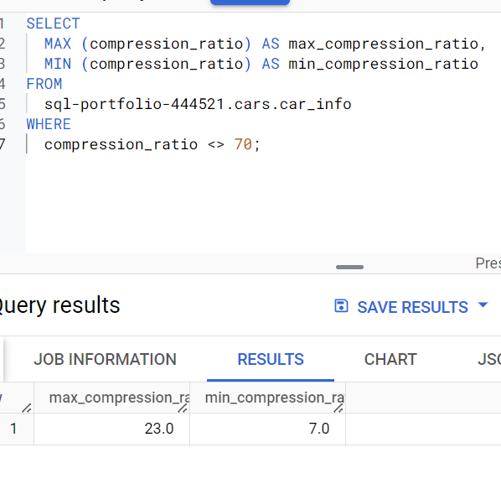
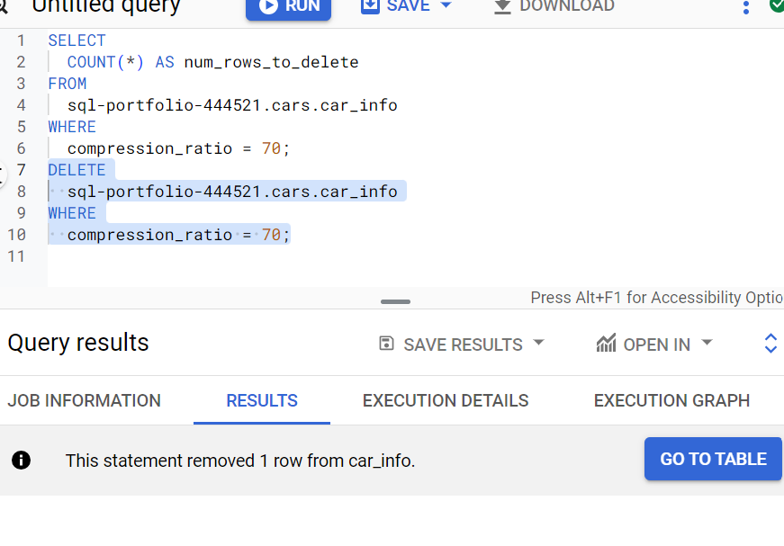
MAX/MIN ranges (removing/deleting <> outliers)

Slide 19
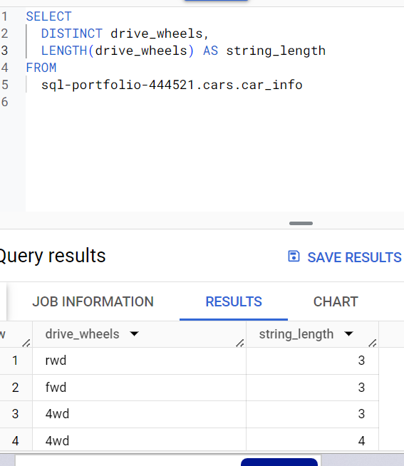
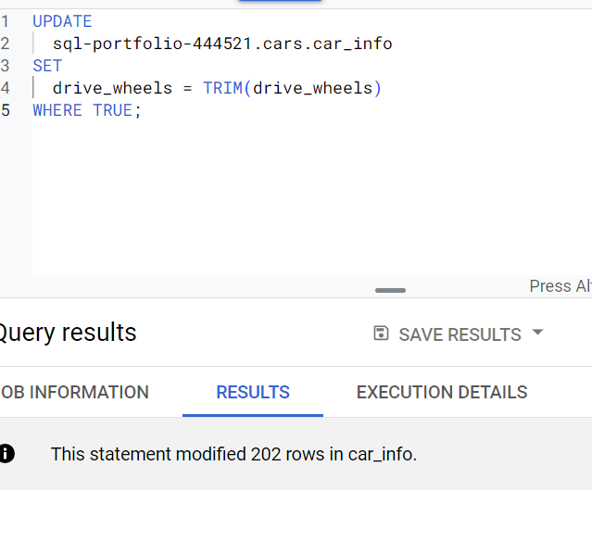
SQL - Multiple Functions

Slide 20
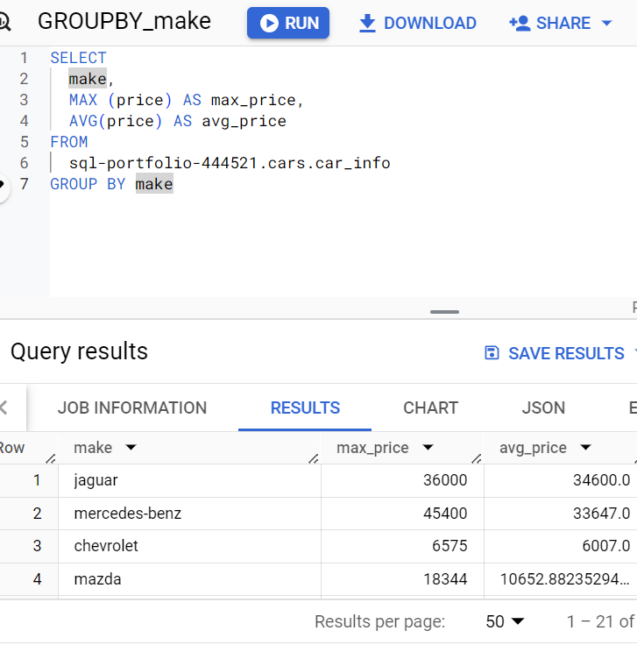
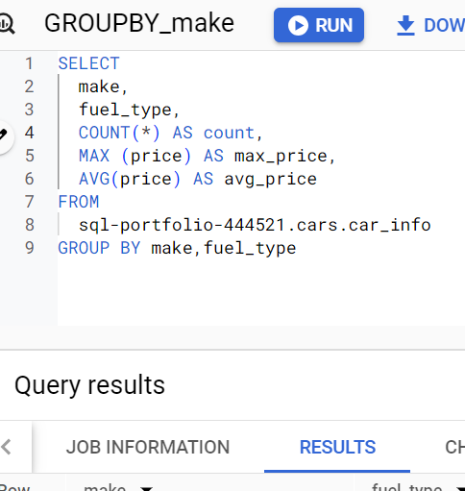
GROUP BY
Applying the GROUPBY to the non-aggregated function for MAX price to align the make with MAX/AVG prices.

Slide 21
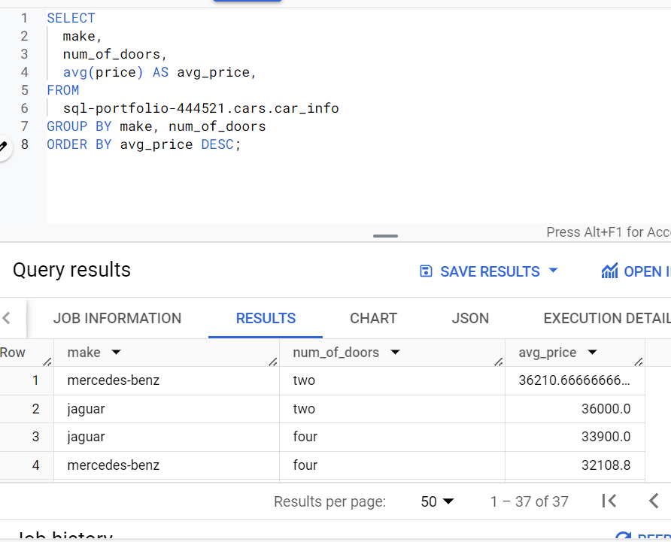
ORDER BY

Slide 22
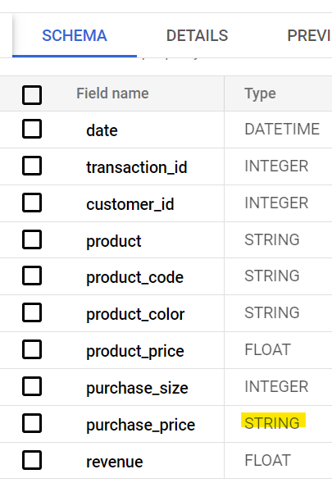
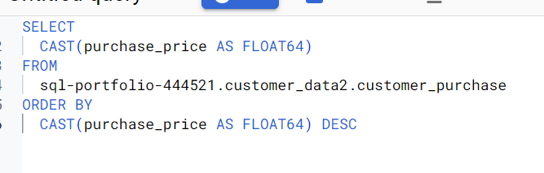
Advanced Function -
CAST()
String -> Float conversion.
Verify change through SCHEMA.
We needed to determine the customer purchase price from greatest to least, but the numbers were being ordered by strings not numerical values. By changing to FLOAT, we can accurately order the values.

Slide 23
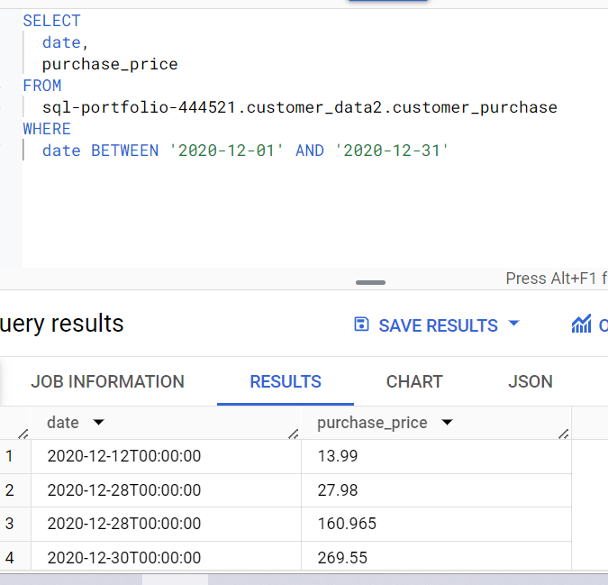
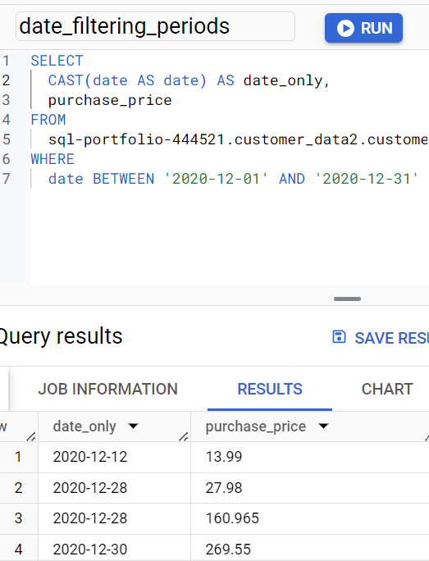
Filtering Date Periods (Correcting String -> Date)

Slide 24
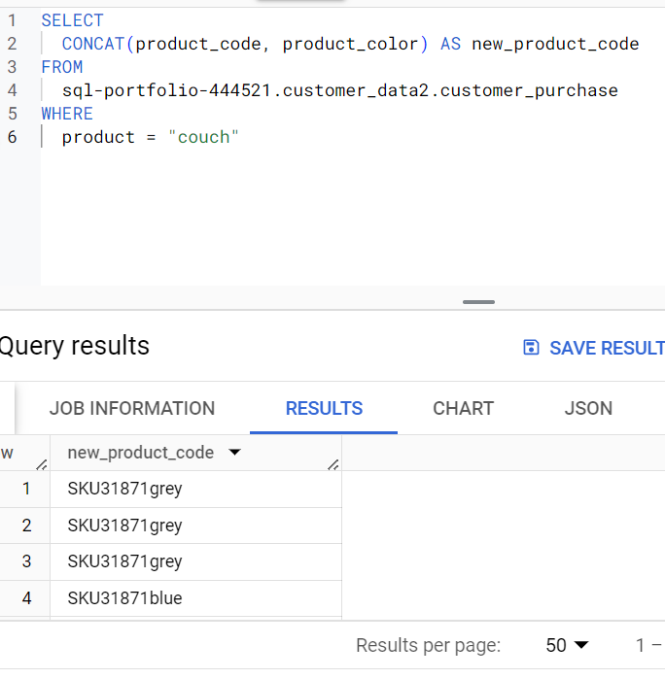
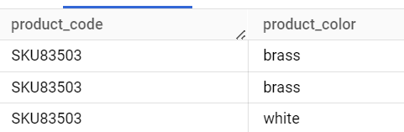
CONCAT()

Slide 25
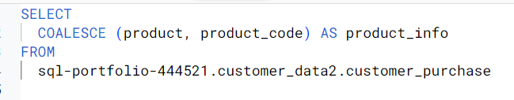
Advanced Function - COALESCE ()
This function replaces NULL’s with another identifier in the column you are trying to calculate total. This would be a placeholder for another field that shows as NULL.

Slide 26
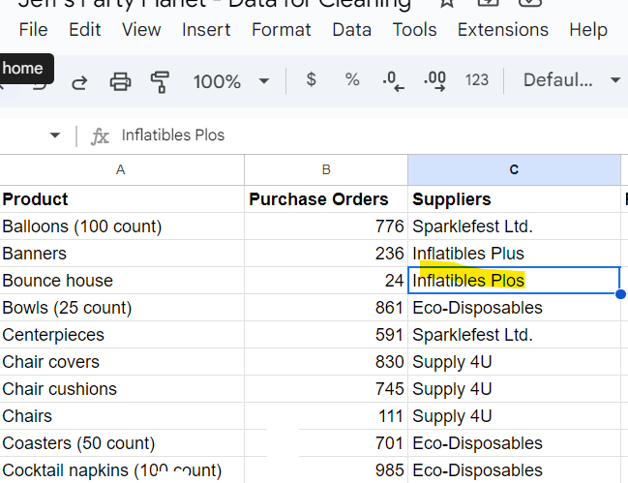
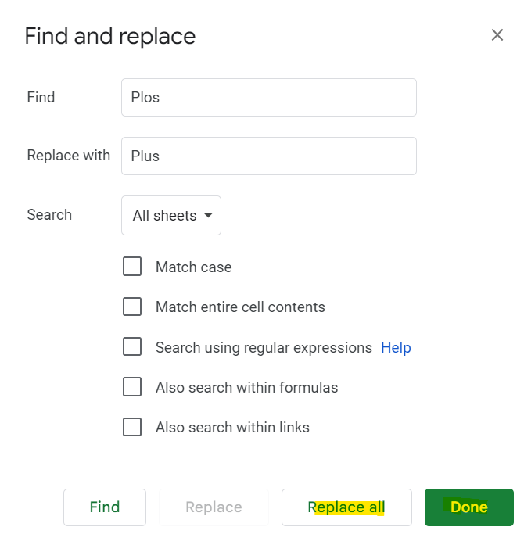
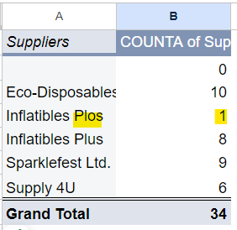
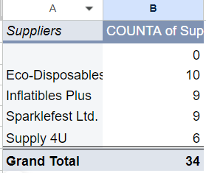
Verifying Data is Cleaned - Excel/Google Sheets Using Pivot Tables/ Find & Replace

Slide 27
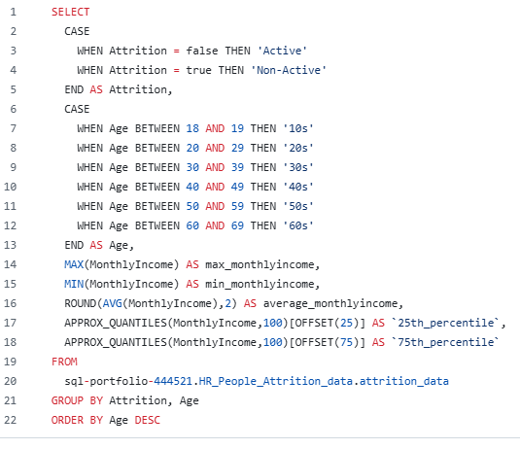
Verifying Data is Cleaning Using SQL CASE()

